Slide 1
Lecture 1: Introduction and Motivation
CMSC5741 Big Data Tech. & Apps.
Prof. Michael R. Lyu
Computer Science & Engineering Dept.
The Chinese University of Hong Kong

Slide 2










Motivation
What do these companies claim in common?
Big Data!

Slide 3
Motivation of the Course
Do you want to understand what is big data? What are the main characteristics of big data?
Do you want to get familiar with the infrastructure and techniques of big data analytics?
Do you want to know the research challenges in the area of big data learning and mining?

Slide 4
Motivation of This Lecture
Introduce the overall structure of this course
Introduce the evolution of big data
Introduce the characteristics of big data
Introduce some problems and lessens of analyzing big data

Slide 5
Outline
Administrative
Introduction

Slide 6
Course Objective
To understand the current key issues on big data and the associated business/scientific data applications;
To teach the fundamental techniques and principles in achieving big data analytics with scalability and streaming capability
To interpret business models and scientific computing results
Able to apply software tools for big data analytics technology

Slide 7
Course Description
This course aims at teaching students the state-of-the-art big data analytics, including techniques, software, applications, and perspectives with massive data.
The class will cover, but not be limited to, the following topics:
distributed file systems such as Google File System, Hadoop Distributed File System, CloudStore, and map-reduce technology;
similarity search techniques for big data such as minhash, locality-sensitive hashing;
specialized processing and algorithms for data streams;
some concepts of machine learning;
big data search and query technology;
big graph analysis;
recommendation systems and matrix factorization;
large scale technologies for support vector machine (SVM) and online learning.

Slide 8
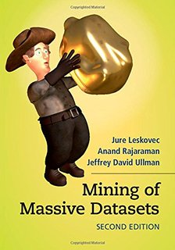



Textbook
Mining of Massive Dataset (2nd edition)
Jure Leskovec
Stanford Assistant Professor
Jon Kleinberg postdoc
CMU graduate
Slovenia undergrad in 2004
Anand Rajaraman
web and technology entrepreneur
co-founder of Cambrian Ventures and Kosmix
Director of Technology at Amazon
co-founder of Junglee Corp (acquired by Amazon for a retail platform)
IIT graduate in 1989
Jeff Ullman
The Stanford W. Ascherman Professor of Computer Science (Emeritus)
Set standards in compilers, theory of computation, data structures, and databases

Slide 9
Textbook
Amazon
http://www.amazon.com/Mining-Massive-Datasets-Jure-Leskovec/dp/1107077230/ref=dp_ob_image_bk
PDF/PPT of the book for online viewing
http://www.mmds.org/
The 2nd edition of the book (v2.1)
http://www.mmds.org/#ver21

Slide 10
Teaching Staff
Instructor: Prof. Michael R. Lyu
www.cse.cuhk.edu.hk/~lyu
lyu@cse.cuhk.edu.hk
Tutor: WU Weibin
wbwu@cse.cuhk.edu.hk

Slide 11
Course Website
Course URL
http://www.cse.cuhk.edu.hk/~cmsc5741

Slide 12
Prerequisites
Algorithms and Data Structures
Basic techniques
Basic probability
Moments, typical distributions, …
Programming
Your choice
We provide some background, but the class will be fast paced

Slide 13
What Will We Learn?
We will learn to analyze different types of data:
Data is high dimensional
Data is a graph
Data is infinite/never-ending
Data is labeled
We will learn to use different models of computation:
MapReduce
TensorFlow
Streams and online algorithms
Single machine in-memory

Slide 14
What Will We Learn?
We will learn to solve real-world problems:
Recommender systems
Link analysis
Large scale image recognition
Community detection
We will learn various “tools”:
Linear algebra (SVD, Rec. Sys., Communities)
Optimization (stochastic gradient descent)
Dynamic programming (frequent itemsets)
Hashing (LSH, Bloom filters)
Deep Learning (TensorFlow)

Slide 15
Course Schedule
wk | Date | Content | Reading Materials
1 | Sept. 3 | Introduction | Ch.1 of MMDS
2 | Sept. 10 | MapReduce/TensorFlow/Frequent Itemsets | Ch.2/6 of MMDS
3 | Sept. 17 | Locality Sensitive Hashing | Ch.3 of MMDS
4 | Sept. 24 | Mining Data Streams | Ch.4 of MMDS
5 | Oct. 8 | Scalable Clustering | Ch.7 of MMDS
6 | Oct. 15 | Dimensionality Reduction | Ch.11 of MMDS
7 | Oct. 22 | Recommendation Systems/Matrix Factorization | Ch.9 of MMDS
8 | Oct. 29 | Midterm Exam
9 | Nov. 5 | Massive Link Analysis | Ch.5 of MMDS
10 | Nov. 13 | Analysis of Massive Graph | Ch.10 of MMDS
11 | Nov. 20 | Large Scale SVM | Ch. 12 of MMDS / notes
12 | Nov. 27 | Online Learning | Ch. 12 of MMDS / notes
13 | Dec. 3 | Project Presentation

Slide 16
Grade Assessment Scheme and Deadlines
Assignments (20%)
2 individual assignments
May include some coding in each assignment
Discussions allowed by no plagiarism
Midterm Examination (40%)
Oct. 29, 6:30pm – 9:30 pm (venue to be announced)
Including Topics 1-7
Open 1 A4-page note (hand-written, double-sided)
Class Project (40%)
Proposal
Presentation
Report

Slide 17
Class Project
Project is for everyone
4-5 persons per project group (TBD)
Each group is to design and implement a big data-related project of choice
Detailed schedule will be announced later

Slide 18
Academic Honesty
Zero Tolerance
Plagiarism, cheating, misconduct in test/exam will be reported to the Faculty Disciplinary Committee for handling.
Penalty
Zero marks for the concerned assignments/test/exam/whole course, reviewable demerits, non-reviewable demerits, suspension of study, dismissal from University.
University Guidelines to Academic Honesty
http://www.cuhk.edu.hk/policy/academichonesty/

Slide 19
Structure

Slide 20
MapReduce (Ch. 2)
R
E
D
U
C
E
Map:
Accepts input key/value pair
Emits intermediate key/value pair
Reduce:
Accepts intermediate key/value* pair
Emits output key/value pair
Very
big
data
M
A
P
Partitioning
Function
Result
Advancement: TensorFlow

Slide 21

Finding Similar Items: Locality Sensitive Hashing (Ch. 3)
Many problems can be expressed as finding “similar” sets:
Find near-neighbors in high-dimensional space
Examples:
Pages with similar words
For duplicate detection, classification by topic
Customers who purchased similar products
Products with similar customer sets
Images with similar features
Users who visited the similar websites

Slide 22
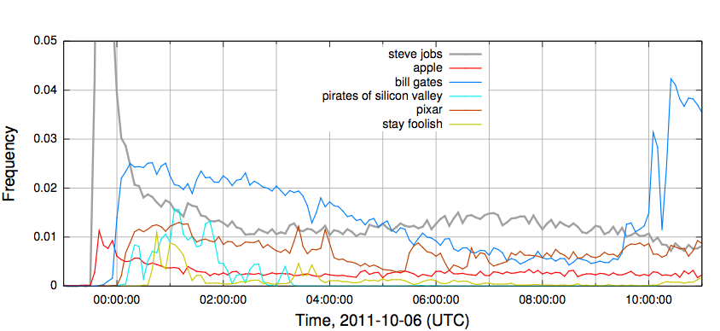
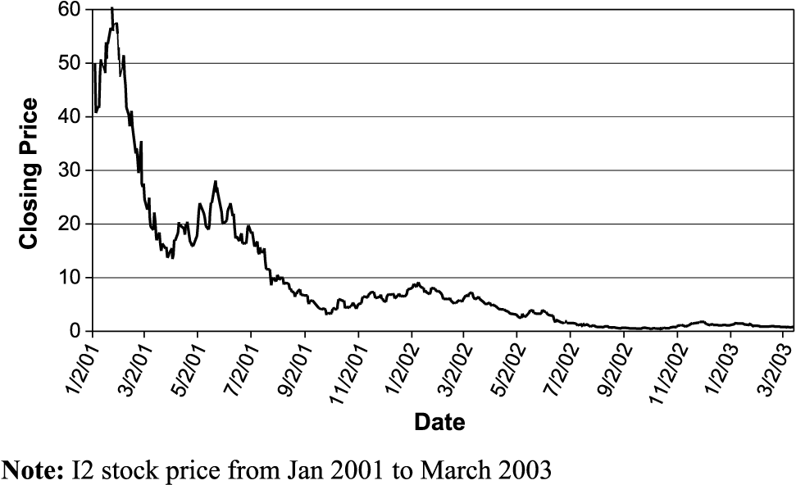
Mining Data Stream (Ch. 4)
Stream Management is important when the input rate is controlled externally:
Google queries
Twitter or Facebook status updates
We can think of the data as infinite and non-stationary (the distribution changes over time)

Slide 23
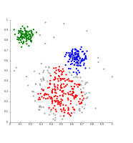
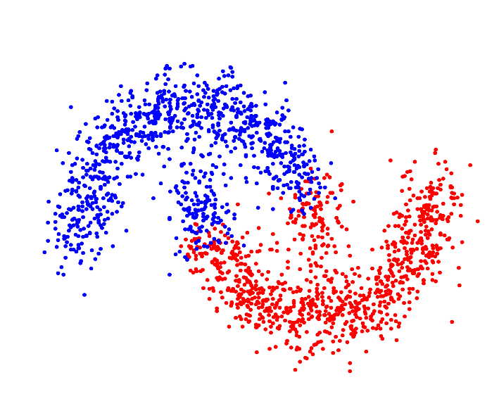
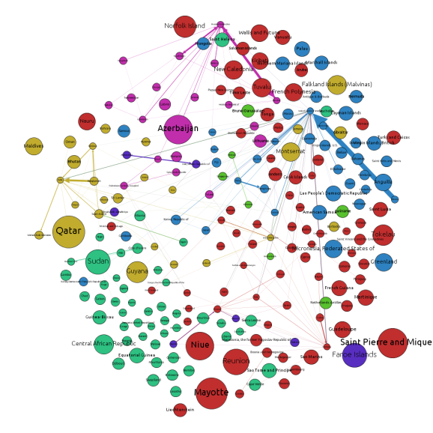
Clustering (Ch. 7)
Given a set of points, with a notion of distance between points, group the points into some number of clusters, so that
Members of a cluster are close/similar to each other
Members of different clusters are dissimilar
Notes:
To understand the structure of the data

Slide 24
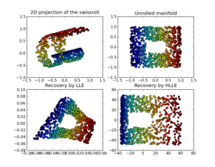
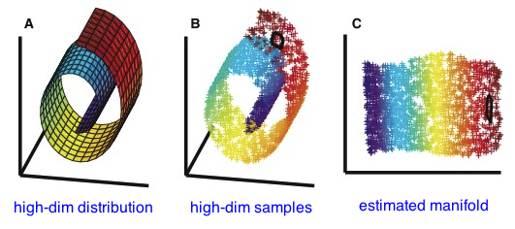
Dimensionality Reduction (Ch. 11)
Discover hidden correlations/topics
Words that occur commonly together
Remove redundant and noisy features
Not all words are useful
Interpretation and visualization
Easier storage and processing of the data

Slide 25

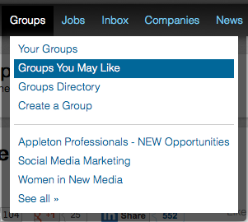
Recommender System (Ch. 9)
Main idea: Recommend items to customer x similar to previous items rated highly by x
Example:
Movie recommendations
Recommend movies with same actor(s),
director, genre, …
Websites, blogs, news
Recommend other sites with “similar”
content

Slide 26
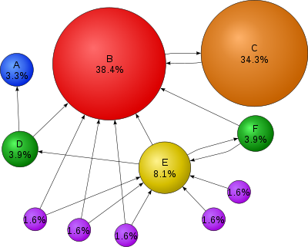
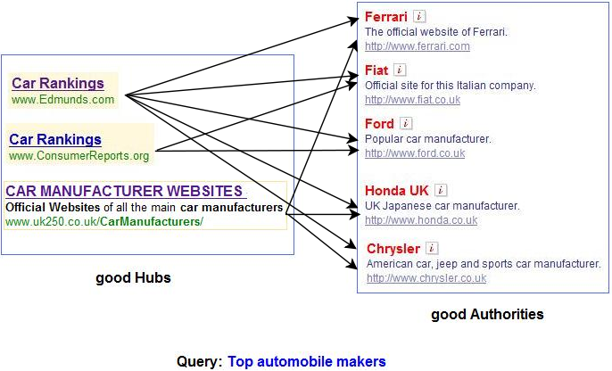
Link Analysis (Ch. 5)
Computing importance of nodes in a graph

Slide 27
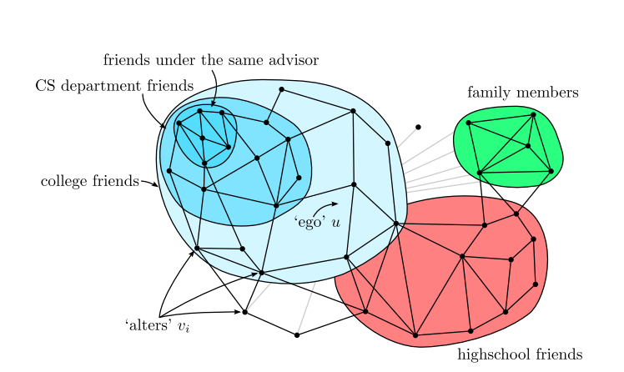
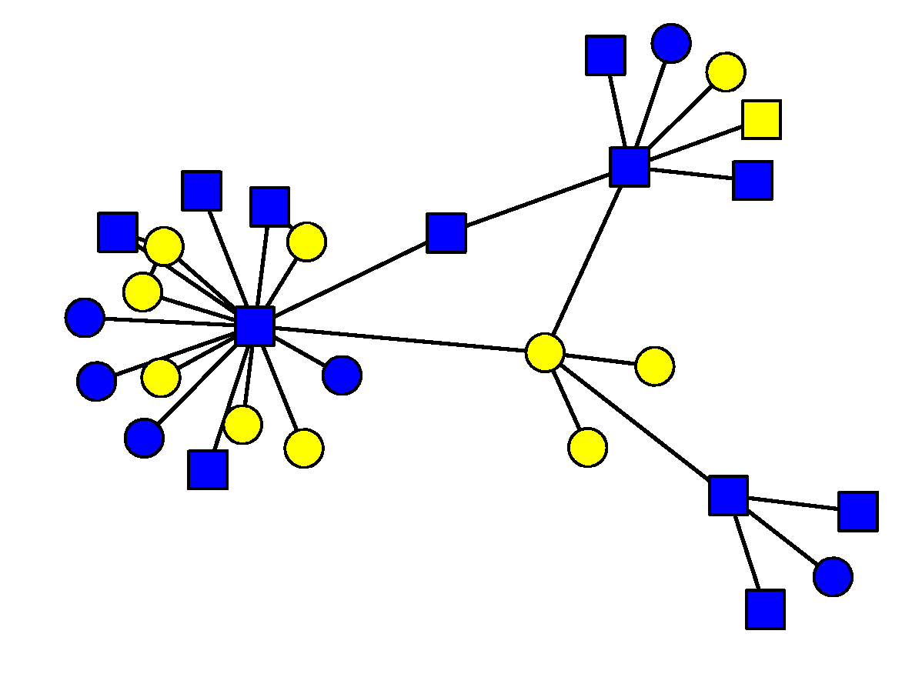
Graph Algorithms (Ch. 10)
To know properties of large-scale networks
Scale-free distribution
Small world effect
To understand social graph structure

Slide 28

Large Scale Classification (Ch. 12)
How does a computer know whether a news belongs to Politics or Economy? Classification
Notes:
News change every second, volume is large

Slide 29
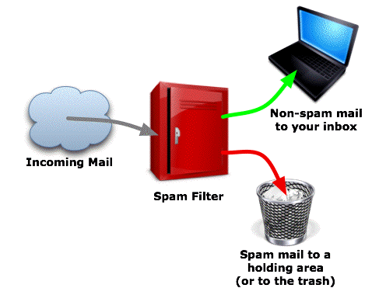
Online Learning Algorithms (Ch. 12)
How to update the decision function and make decision as a new sample comes?

Slide 30
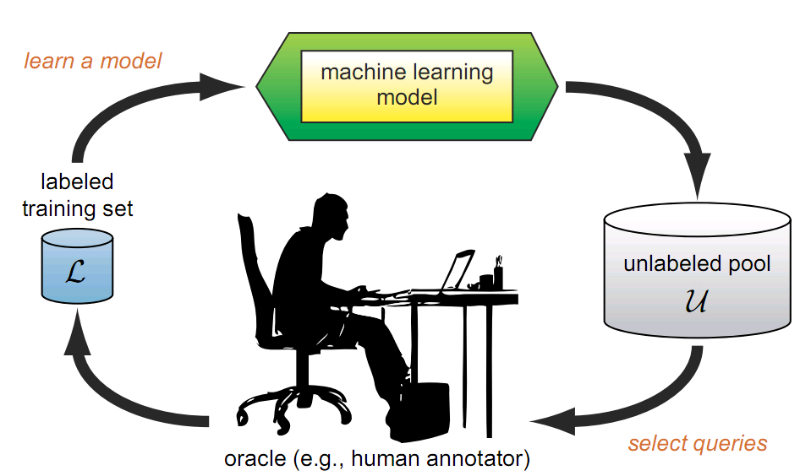
Active Learning
What is Active Learning?
A learning algorithm is able to interactively query the user (or some other information source) to obtain the desired outputs at new data points

Slide 31
In-class Practice
Go to practice

Slide 32
Outline
Administrative
Introduction

Slide 33
Introduction to Big Data

Slide 34
Definition of Big Data
Big data is the study and applications of data sets so big and complex that traditional data-processing application software are inadequate to deal with them.
From wiki

Slide 35
Evolution of Big Data
Birth: 1880 US census
Adolescence: Big Science
Modern Era: Big Business

Slide 36
Birth: 1880 US census

Slide 37
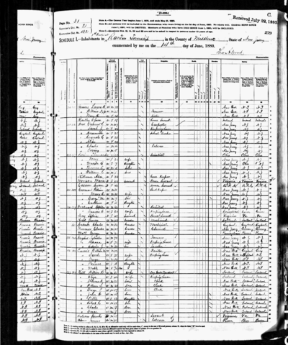
The First Big Data Challenge
1880 census
50 million people
Age, gender (sex), occupation, education level, no. of insane people in household
Notes:
Took over seven years to manually tabulate and report on the data

Slide 38
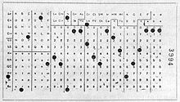
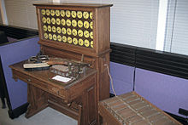
The First Big Data Solution
Hollerith Tabulating System
Punched cards – 80 variables
Used for 1890 census
6 weeks instead of 7+ years
Notes:
A mechanical device called the Hollerith Tabulating system, which worked with punch cards that could hold about 80 variables.
The HT system revolutionized the value of census data, making it actionable and increasing its value an untold amount. Analysis took six weeks instead of seven years. It allowed the government to act on information in a reasonable amount of time.
The ability to analyze the 1890 census led to an improved understanding of the populace, which the government could use to shape economic and social policies ranging from taxation to education to military conscription.

Slide 39

Manhattan Project (1946 - 1949)
$2 billion (approx. 26 billion in 2013)
Catalyst for “Big Science”
Notes:
The next giant leap for Big Data Analytics came with the Manhattan project, the US development of the atomic bomb during World War II.
The Manhattan project not only introduced the concept of Big Data analysis with computers, it was also the catalyst for Big Science

Slide 40

Space Program (1960s)
Began in late 1950s
An active area of big data nowadays
Notes:
It was driven by a Space Race between the Sovient Union and the United States, the launch of the first man-made objective to orbit the Earth, the USSR’s Sputnik 1, on 4 October 1957, the first Moon landing by the American Apollo 11 craft on 20 July 1969.

Slide 41
Adolescence: Big Science

Slide 42
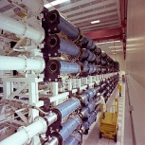
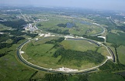
Big Science
The International Geophysical Year
An international scientific project
Last from Jul. 1, 1957 to Dec. 31, 1958
A synoptic collection of observational data on a global scale
Implications
Big budgets, Big staffs, Big machines, Big laboratories
Notes:
The International Geophysical Year (IGY) was an international scientific project that lasted from July 1, 1957, to December 31, 1958. It marked the end of a long period during the Cold War when scientific interchange between East and West had been seriously interrupted. Joseph Stalin’s death in 1953 opened the way for this new era of collaboration. Sixty-seven countries participated in IGY projects, although one notable exception was mainland China, which was protesting against the participation of the Republic of China (Taiwan).

Slide 43
Summary of Big Science
Laid foundation for ambitious projects
International Biological Program
Long Term Ecological Research Network
Ended in 1974
Many participants viewed it as a failure
Nevertheless, it was a success
Transform the way of processing data
Realize original incentives
Provide a renewed legitimacy for synoptic data collection
Notes:
The project laid the foundation for more ambitious projects that gathered more specialized data for specific analysis, such as the International Biological Program and later the Long Term Ecological Research Network. Both increased the mountains of data gathered, incorporated newer analysis technologies, and push IT technology further into the spotlight.
The IBP encountered difficulties when the institutional structures, research methodologies, and data management implied by the Big Science mode of research collided with the epistemic (认识的) goals, practices, and assumptions of many of the scientists involved.
Way of processing data: collect, share, analyze, and redefine how IT can be used for data analysis
Incentives: emphasis on Big Data, implementation of the organizational structure of Big Science
Synoptic: 提纲的，概要的

Slide 44
Lessons from Big Science
Spawn new big data projects
Weather prediction
Physics research (supercollider data analytics)
Astronomy images (planet detection)
Medical research (drug interaction)
…
Businesses latched onto its techniques, methodologies, and objectives

Slide 45
Modern Era: Big Business

Slide 46
Big Science vs. Big Business
Common
Need technologies to work with data
Use algorithms to mine data
Big Science
Source: experiments and research conducted in controlled environments
Goals: to answer questions, or prove theories
Big Business
Source: transactions in nature and little control
Goals: to discover new opportunities, measure efficiencies, uncover relationships
Notes:
From sources that are transactional in nature and have little control over the original of the data
Use Big Data to uncover relationships among what was thought to be unrelated data sets

Slide 47

Big Data is Everywhere Today!
Lots of data is being collected and warehoused
Web data, e-commerce
Purchases at department/ grocery stores
Bank/Credit Card transactions
Social Networks

Slide 48
How Much Data?
IDC reports
2.7 billion terabytes in 2012
8 billion terabytes in 2015
44 zettabytes (10²¹) by 2020
Sources
Structured corporate databases
Unstructured data from webpages, blogs, social networking messages, …
Countless digital sensors, smart IoTs
Volume
Google processes 20 PB (10¹⁵) a day of user-generated data for 1 trillion searches a year
Facebook in one day:
2.5B - content items shared
3.2B - ‘Likes’
350M - photos uploaded
100+PB - disk space in a single HDFS cluster
105TB - data scanned via Hive (30min)
2B - queries executed
500+ TB (10¹²) - new data ingested
Notes:
International Data Corporation

Slide 49
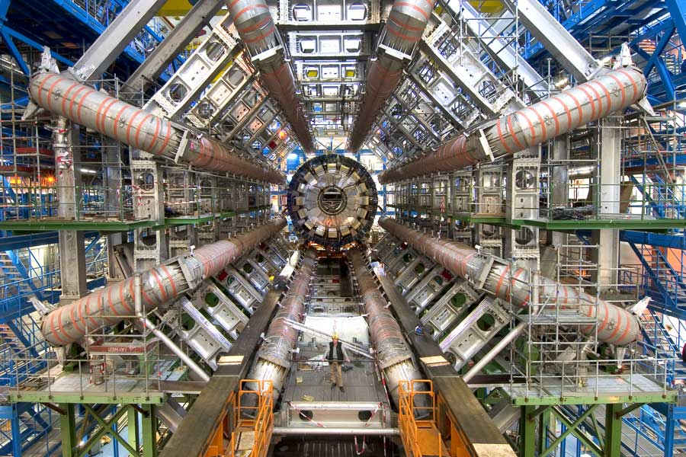
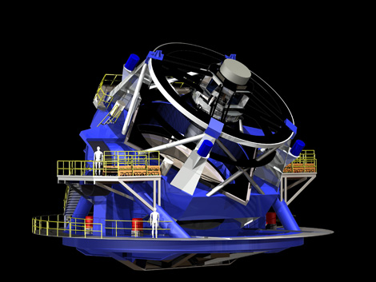
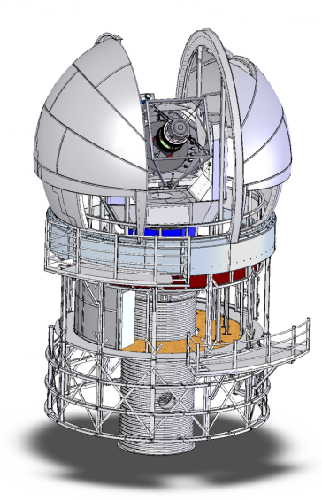
Big Science
CERN - Large Hadron Collider
~10 PB/year at start
~1000 PB in ~10 years
2500 physicists collaborating
Large Synoptic Survey Telescope (NSF, DOE, and private donors)
~5-10 PB/year at start in 2012
~100 PB by 2025
Pan-STARRS (Haleakala, Hawaii) US Air Force
now: 800 TB/year
soon: 4 PB/year
Notes:
CERN – Acronym for the French "Conseil Européen pour la Recherche Nucléaire", or European Council for Nuclear Research.
Pan-STARRS – the Panoramic Survey Telescope & Rapid Response System, an innovative design for a wide-field imaging facility developed at the University of Hawaii's Institute for Astronomy.
Hadron: 强粒子. Large Hadron Collider, for example, costing between $5 and $10 billion

Slide 50


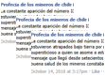




Characteristics of Big Data: 4V
Volume
Velocity
Variety
Veracity
Volume
Volume
Volume
Volume
From terabytes to exabyte to zetabytes of existing data to process
Batch data, real-time data, streaming data, milliseconds to seconds to respond
Structured, semi-structured, unstructured, text, pictures, multimedia
Uncertainty due to data inconsistency & incompleteness, ambiguities, deception, model approximation
Text
Images
8 billion TB in 2015, 44 ZB in 2020
5.2TB per person
New sharing over 2.5 billion per day
new data over 500TB per day
Videos
Audios

Slide 51




Big Data Analytics
Definition: A process of inspecting, cleaning, transforming, and modeling big data with the goal of discovering useful information, suggesting conclusions, and supporting decision making
Hot in both industrial and research societies

Slide 52
Big Data Analytics
Related conferences
IEEE Big Data
IEEE Big Data and Distributed Systems
WWW
KDD
WSDM
CIKM
SIGIR
AAAI/IJCAI
NIPS
ICML
TREC
ACL
EMNLP
COLING
…

Slide 53
Types of Analytics at Amazon / Alibaba
Basically measure anything possible - A few examples:
Marketing
Buyer Experience
Finance
Trust & Safety
Technology Operations
Customer Service
Loyalty
Information Security
Infrastructure
Finding
User Behavior
Seller Experience

Slide 54
What is Data Mining?
Discovery of patterns and models that are:
Valid: hold on new data with some certainty
Useful: should be possible to act on the item
Unexpected: non-obvious to the system
Understandable: humans should be able to interpret the pattern
A particular data analytics technique

Slide 55
Data Mining Tasks
Descriptive Methods
Find human-interpretable patterns that describe the data
Predictive Methods
Use some variables to predict unknown or future values of other variables

Slide 56
Data Mining: Culture
Data mining overlaps with:
Databases (DB): Large-scale data, simple queries
Machine learning (ML): Small data, Complex models
Statistics (stats): Predictive Models
Statistics/
AI
Machine learning/
Pattern Recognition
Different cultures:
To a DB person, data mining is an extreme form of analytic processing – queries that examine large amounts of data
Result is the query answer
To a stats/ML person, data-mining is the inference of models
Result is the parameters of the model
Data Mining
Database systems

Slide 57
Relation between Data Mining and Data Analytics
Analytics include both data analysis (mining) and communication (guide decision making)
Analytics is not so much concerned with individual analyses or analysis steps, but with the entire methodology

Slide 58
Meaningfulness of Answers
A big data-analytics risk is that you will “discover” patterns that are meaningless
Statisticians call it Bonferroni’s principle:
(roughly) if you look in more places for interesting patterns than your amount of data will support, you are bound to find crap

Slide 59
Examples of Bonferroni’s Principle
Total Information Awareness (TIA)
In 2002, intend to mine all the data it could find, including credit-card receipts, hotel records, travel data, and many other kinds of information in order to track terrorist activity
A big objection was that it was looking for so many vague connections that it was sure to find things that were bogus and thus violate innocents’ privacy

Slide 60
The “TIA” Story
Suppose we believe that certain groups of evil-doers are meeting occasionally in hotels to plot doing evil
We want to find (unrelated) people who at least twice have stayed at the same hotel on the same day

Slide 61
Details of the “TIA” Story
10⁹ people might be evil-doers
Examining hotel records for 1000 days
Each person stays in a hotel 1% of the time (10 days out of 1000)
Hotels hold 100 people (so 10⁵ hotels, 1% of total people)
If everyone behaves randomly (i.e., no evil-doers) will the data mining detect anything suspicious?

Slide 62
Calculation (1)
q at
some
hotel
p at
some
hotel
Same
hotel
Probability that given persons p and q will be at the same hotel on given day d:
1/100 × 1/100 × 10⁻⁵ = 10⁻⁹.
Probability that p and q will be at the same hotel on given days d₁ and d₂:
10⁻⁹ × 10⁻⁹ = 10⁻¹⁸.
Pairs of days:
5×10⁵

Slide 63
Calculation (2)
Probability that p and q will be at the same hotel on some two days:
5×10⁵ × 10⁻¹⁸ = 5×10⁻¹³
Pairs of people:
5×10¹⁷
Expected number of “suspicious” pairs of people:
5×10¹⁷ × 5×10⁻¹³ = 250,000

Slide 64
Summary of the “TIA” Story
Suppose there are 10 pairs of evil-doers who definitely stayed at the same hotel twice
Analysts have to sift through 250,000 candidates to find the 10 real cases
Make sure the property, e.g., two people stayed at the same hotel twice, does not allow so many possibilities that random data will surely produce “facts of interest”
Understanding Bonferroni’s Principle will help you look a little less stupid than a parapsychologist
Notes:
Parapsychologist: 心灵学家

Slide 65
Things Useful to Know
TF.IDF measure of word importance
Hash functions
Secondary storage (disk)
The base of natural logarithms
Power laws
Notes:
Please read the textbook Section 1.3.

Slide 66
One-Slide Takeaway
What is the structure of this course?
What is big data?
What are the 4Vs characteristics of big data?
What is the history of big data?
What is big data analytics?
Is there any framework in big data analytics?

Slide 67
In-Class Practice
Let us examine fragrance sales at Amazon in a year. Suppose
the best selling product sold 100,000 pieces,
the 10th best-selling product sold 1,000 pieces,
the 100th best selling product sold 10 pieces.
How to derive the relationship between the number of fragrance sold and the order?

